Slide 1
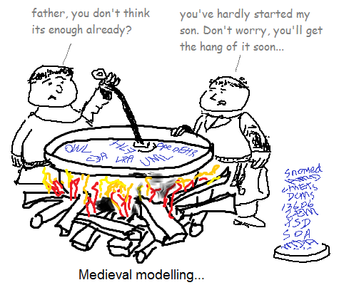
Models, architecture, frameworks in e-health
Thomas Beale, July 2011

Slide 2
The Archetype framework

Slide 3
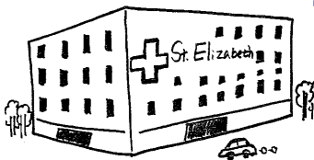
Historical Industry Structure
Stds orgs +
Professional
bodies
DOCs & Patients
GOVs / MoHs
VENDOR / INTEGRATOR
docs
Proprietary form definitions
GUI
...use systems
data dictionaries
Present’n
code
terminology
APPS
& SYSTEMS
Msg specs
XSD
...manual
Write docs, create message specs
... Write data specs, minimum data sets, schemas for DS, referral etc
...consume
documents and msg specs
developers
... make up what they don’t understand
PROVIDERS
Buy (poor)
Solutions

Slide 4
Historical Industry Structure
Stds orgs +
Professional
bodies
DOCs & Patients
GOVs / MoHs
VENDOR / INTEGRATOR
docs
Proprietary form definitions
GUI
...use systems
Lock-in
Chaotic,
Expensive, non-computable
data dictionaries
Present’n
code
Poor interop- erability
terminology
APPS
Ad hoc
& SYSTEMS
Msg specs
XSD
...manual
Expensive,
low reuse
Write docs, create message specs
... Write data specs, minimum data sets, schemas for DS, referral etc
...consume
documents and msg specs
developers
... make up what they don’t understand
PROVIDERS
Buy (poor)
Solutions

Slide 5
Archetype approach
Stds orgs +
Professional
bodies
DOCs & Patients
GOVs / MoHs
VENDOR / INTEGRATOR
terminology
GUI
...use systems
Collaborative
knowledge repository
templates
Operational template
TOOL
TDO
Present’n
archetypes
APPS
& SYSTEMS
templates
XSD
Platform
TOOL
TOOL
TOOL
TOOLS
build archetypes
& terminology that define their
Information –
e.g. via IHTSDO
...build templates and issue as standards
e.g. Discharge
Summary
...consume
std templates and
create their own,
making OPTs
developers
build
SOLUTIONS
based on
the platform
PROVIDERS
buy
Solutions

Slide 6
Archetype approach
GUARANTEED SEMANTICS
Stds orgs +
Professional
bodies
DOCs & Patients
GOVs / MoHs
VENDOR / INTEGRATOR
terminology
GUI
...use systems
Collaborative
knowledge repository
Joining
point
Open, reusable
templates
Operational template
TOOL
TDO
Present’n
archetypes
Interop- erable
APPS
& SYSTEMS
templates
XSD
Standard tools
Easy
Development
Platform
TOOL
TOOL
TOOL
TOOLS
build archetypes
And terminology that define their
Information –
e.g. via IHTSDO
...build templates and issue as standards
e.g. Discharge
Summary
Cheaper,
faster
...consume
std templates and
create their own,
making OPTs
developers
build
SOLUTIONS
based on
the platform
PROVIDERS
buy
Solutions
Knowledge engineering
Software engineering

Slide 7
Tool-based standards
Nat’l / local
templates
java
Int’l
archetypes
Nat’l / local
archetypes
C#
etc
OPT
Msg XSD
Reference Model
DocXSD
GUI XML
re
f
s
e
ts
terminology
Querying
native
openEHR
data
All data in one RM

Slide 8
Tool-based standards
IHE
java
HL7v2
C#
OPT
etc
CDA XSD
Msg XSD
Reference Model
DocXSD
epSOS XSD
GUI XML
re
f
s
e
ts
terminology
13606 XSD
Querying
data

Slide 9
The key....
Is the operational template (OPT) – this is the joining point between the semantic specifications and deployable software artefacts that can be used by normal developers

Slide 10
Key Outcomes
Normal developers can engage
→ they use generated downstream models
Semantic connection exists between definitions and implementations
→ now we know what the meaning of data are, and DS and BI can work...
No semantic framework ➔ no ‘serious’ computing with the data

Slide 11
This framework works, regardless of the specific architecture or models
However, to create a coherent architecture, coherent models must be used

Slide 12
It’s a game-changer...
This framework changes the whole standards game because:
It locates different kinds of models in the right places
It says how they must formally relate
i.e. It shows how various kinds of things can co-exist
Practically, it allows us to properly understand what to do with all the different reference models, document standards, message standards and so on

Slide 13
How openEHR uses the framework
Level 1: the reference model is a fairly typical object model, of around 100 classes (including data types)
Level 2: archetypes are constraints on the reference model, and define legal data items
Level 3: templates are aggregators (with further constraints) on archetypes, that define data sets underlying forms, messages and reports
Queries are defined based on archetypes

Slide 14
The Semantic architecture of openEHR
Screen Forms
Messages
1:N
Reports
1:N
Templates
Terminology
interface
Data conversion
schemas
1:N
Terminologies
Archetypes
Snomed CT
Querying
1:N
ICDx
Reference Model
What openEHR
provides
ICPC

Slide 15
Strategic significance of the framework

Slide 16
Benefits...
An integrated, self-consistent health computing platform
An open, scalable content modelling formalism that works (ADL/AOM) and allows clinical professionals to engage directly
A 4-level architecture that maximises reuse
A portable querying language (AQL) that enables decision support & BI to talk to EHR
A framework for integrating data standards

Slide 17
Integration and Computability for standards
IHE
java
HL7v2
C#
OPT
etc
CDA XSD
Msg XSD
Reference Model
DocXSD
epSOS XSD
GUI XML
re
f
s
e
ts
terminology
13606 XSD
Querying
data

